Slide 1


Retail Industry&&Analytics
Yijun Wang
POWERPOINT

Slide 2
01
DEFINITION
1. sell the products to personal or family
2. Retailers can be both retail and institutional .
Retail
Notes:
By “retail” we mean the market that includes all those activities that involve the sale of goods or services by a company directly to the consumer that are usually purchased for personal or family use.

Slide 3


7 TYPES OF ACTIVITIES
Mobile Retail
“Fixed location” retail
Internet Retail
Discount Stores
Supermarket
Vending Machines
Temporary shops
Notes:
While it is true that retail is a B2C market, there are many ways to achieve this. In light of this, it is possible to make a further distinction within the retail sector. If we look at the different types of retailers, we can list at least 7 different types of activities, but I will just put the most common activities over here.

Slide 4
DIGITAL SQUARE
Over 39 Million
50 Million
93%
30%
The number of people purchased goods online is growing steadily
Accessing internet,
Number is also growing year by year
People visited at least one online store from any device
e-commerce has grown by 30%
Reference”
https://www.doxee.com/blog/customer-experience/retail-industry-definition-distinctions-between-brick-and-digital/
Notes:
According to recent surveys, more than 50 million people access the Internet, a number that is growing year by year. Of these, 93% have visited at least one online store from any device and 77% of them, last year, purchased a good or service online, using a personal computer or smartphone. Similarly, the number of people who purchased goods online in 2019 is also growing steadily, with more than 39 million consumers.

Slide 5
02
The Power of
Retail Analytics

Slide 6
Predicting Spending
Amazon based on “guess what you like”, generated 29% of sales which analyzes more than 150 million accounts.
Optimize pricing
Get the most value out of upcoming trends and know when, and how much, to decrease off-trend product prices.
HOW DO RETAILERS COLLECT DATA?
Forecasting Demand
Analyze social media and web browsing trends to predict the next big thing in the retail market.
Customer Journey Analytics
The only way to get a handle on the customer journey and create better experiences is to use big data.
Notes:
retail industry collected through credit card transactions, IP addresses, user log-ins and more. As more information is collected, retail businesses can use market insights to analyze the ebb and flow of shopping and spending by consumers historically to predict future spending and make personalized recommendations.

Slide 7


RETAIL ANALYTICS
Big Data to optimize pricing
Supply Chain Movement
Customer loyalty
Create customer recommendations
Improved customer service
Making strategic decisions based on market analysis
Notes:
Big data describes a large volume of data that is used for human behavior and interactions. For the retail industry, big data means a greater understanding of consumer shopping habits and how to attract new customers. Big data analytics in retail enables companies to create customer recommendations based on their purchase history, resulting in personalized shopping experiences and improved customer service. These super-sized data sets also help with forecasting trends and making strategic decisions based on market analysis.

Slide 8
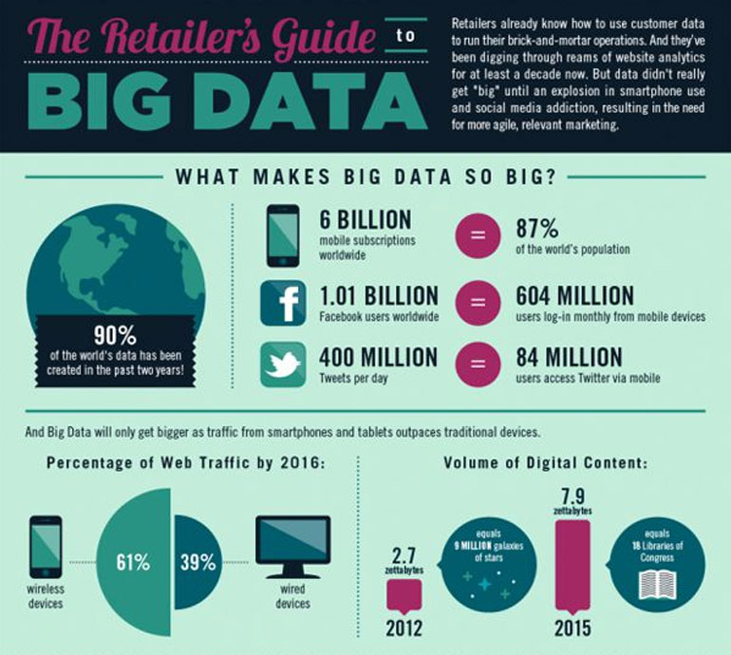
retailers that embrace big data analytics yield a 60% boost in margins
1% improvement in labour productivity.
Reference”
https://www.allerin.com/blog/2840-2
Notes:
好消息是，big data analytics is turning into an advanced tool helping companies grow their business based on objective data, as opposed to subjective knowledge. Meanwhile, big data analytics in the retail sector are bringing billions to the bottom line of industry leaders as we can see from the picture.

Slide 9
DATA HARNESSING
The bad news is that while many merchants are collecting data, most aren’t using it effectively.
16%
24%
60%
consider themselves experts.
say they are “newbies”
say they are getting there.
Reference”
https://www.vendhq.com/blog/how-retailers-can-use-data-to-boost-productivity-customer-service-sales/
Notes:
The bad news is that while many merchants are collecting data, most aren’t using it effectively. According to the study, only 16% consider themselves experts when it comes to data harnessing, while 24% and 60%, respectively, describe themselves as “newbies” and “getting there.”

Slide 10
03
ANALYTICS POSITIONS
Job demand, average salary, core skill

Slide 11
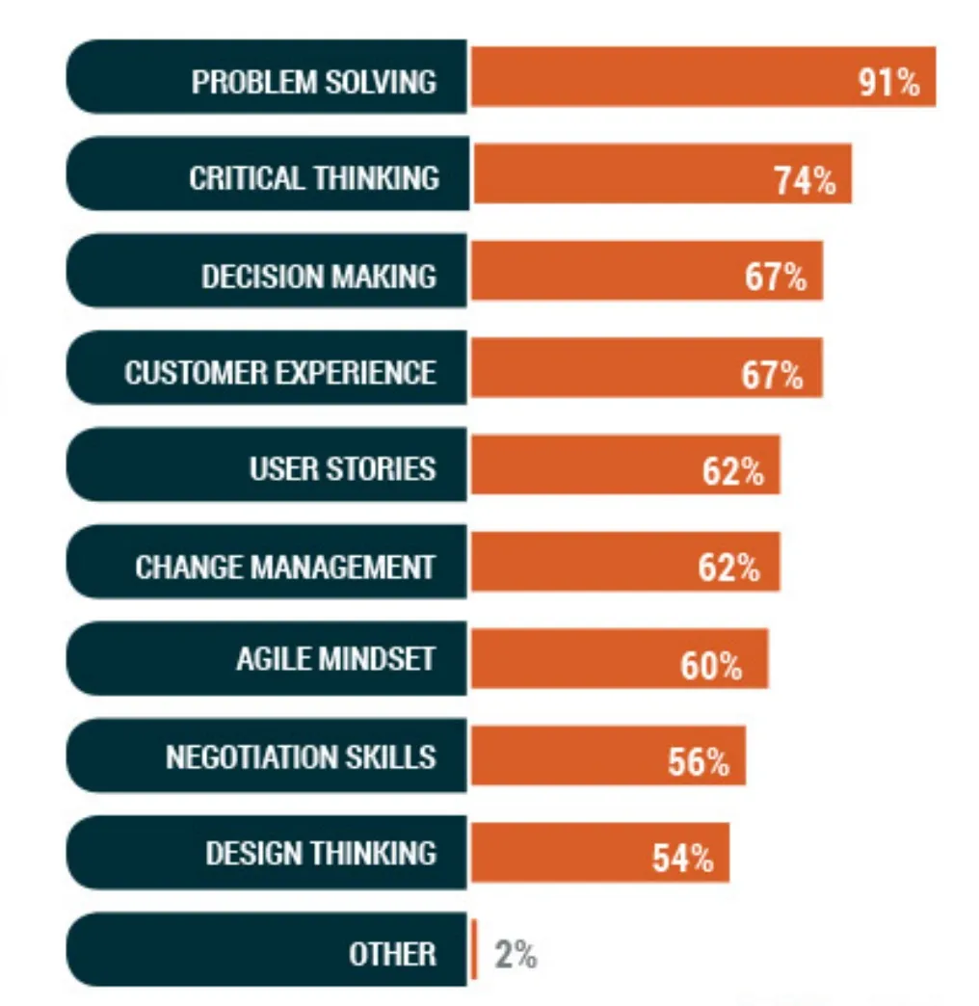
BUSINESS ANALYST SKILLS
Make or break – an expression that is very common in business to mean a situation or event or period that is extremely important because
Here’s a story for you: sarah perry was a veterinary nurse who had been working daily.Who had been working daily.
Here’s a story for you: sarah perry was a veterinary nurse who had been working daily.Who had been working daily.
Here’s a story for you: sarah perry was a veterinary nurse who had been working daily.Who had been working daily.
Here’s a story for you: sarah perry was a veterinary nurse who had been working daily.Who had been working daily.
Reference”
https://thebadoc.com/ba-articles/f/top-business-analyst-skills-of-2019-and-how-to-master-them
Notes:
The business analyst position requires both hard skills and soft skills. Business analysts need to know how to pull, analyze and report data trends, and be able to share that information with others and apply it on the business side. Not all business analysts need a background in IT as long as they have a general understanding of how systems, products and tools work.

Slide 12
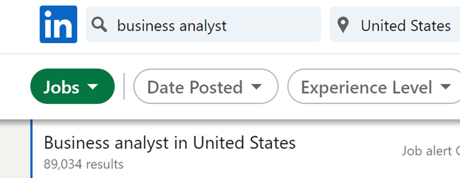
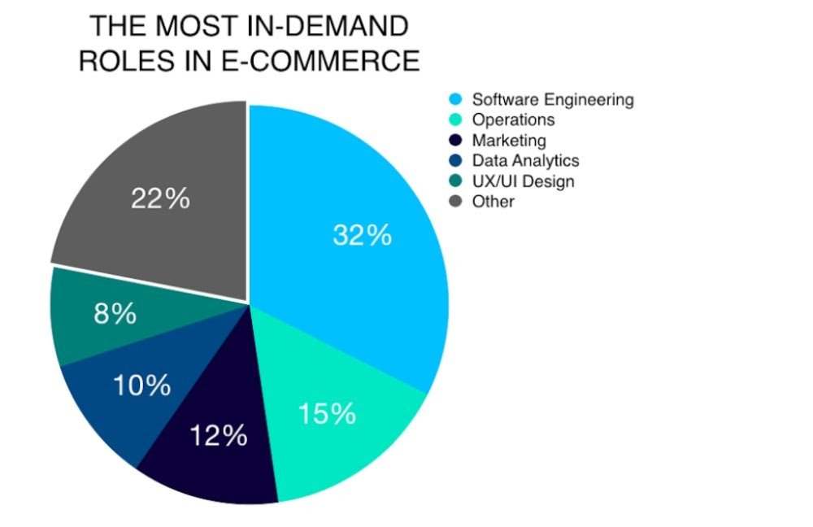
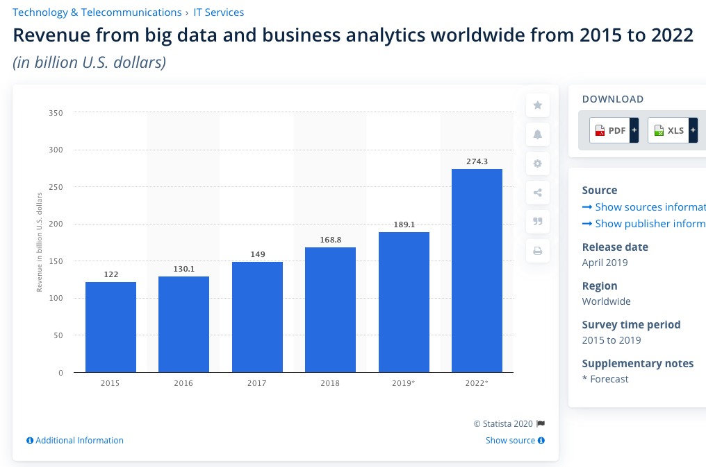
Revenue from Business Analytics
(from 2015 to 2022)
Demand Roles
Reference”
https://www.kbvresearch.com/big-data-analytics-in-retail-market/
https://www.bigcommerce.com/blog/ecommerce-jobs/
Notes:
The left pie chart is describing these roles are amongst the most sought after. They're more likely to use ready-made ecommerce platforms or outsource development work. The biggest brands – who can afford the higher wages – are where these roles exist.
And the right side chart told us that using big data and business analytics can help revenue increase,year by year. According to a study by the Mckinsey Global Institute, retailers that embrace big data analytics yield a 60% boost in margins and a 1% improvement in labour productivity.

Slide 13
120,400
806,400
Business Analytics
Job Market
14.3%
19,650
Reference”
https://www.careerexplorer.com/careers/business-analyst/job-market/
Notes:
There are currently an estimated 806,400 business analysts in the United States. The business analyst job market is expected to grow by 14.3% between 2016 and 2026. Over the next 10 years, it is expected the US will need 120,400 business analysts. That number is based on over 1 hundred 15 thounstnds additional business analysts, and the retirement of 5,200 existing business analysts. Currently there are 19650 BA at WA.

Slide 14
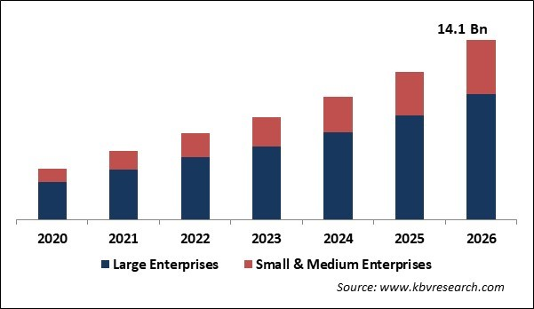
Big Data Analytics in Retail Market
Organization Size
2020-2026
Market Report Description
The Global Big Data Analytics in Retail Market size is expected to reach $14.1 billion by 2026
rising at a market growth of 23.4% CAGR during the forecast period.
Reference”
https://www.kbvresearch.com/big-data-analytics-in-retail-market/
Notes:
The Global Big Data Analytics in Retail Market size is expected to reach $14.1 billion by 2026, rising at a market growth of 23.4% CAGR during the forecast period.

Slide 15
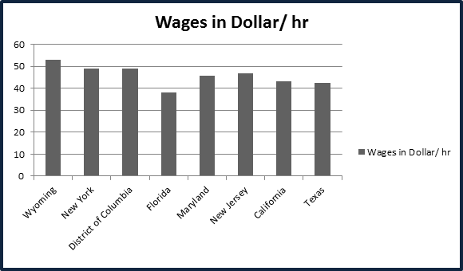
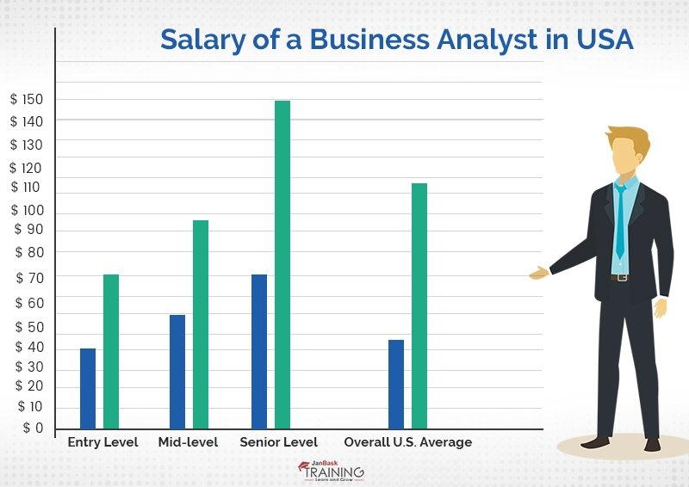
Salary in USA
Wages in different State
Min
Max
Entry Level Average
5.5k
Mid-level Average
7.5k
Senior Level Average
11.0k
Reference”
https://www.janbasktraining.com/blog/business-analyst-salary/
Notes:
The pay evaluation plan is broken into three parts: high-level, middle-level, and low-level depending on the applicant's understanding and capabilities. To clear the air about the Salary of a Business Analyst further, they have collected some useful data, facts, and figures about the salary of Business Analyst all across the USA. So, the salary’s based on the location.

Slide 16
THANKS
Notes:
对我而言，我最理想得工作也是做BA，因为我觉得数据对于一个公司来说是最重要得一个part。Managing the data effectively and making it useful for analytics is the core focus for retailers at this point. The total amount of data keeps growing in the retail industry every day. This data can be used for gaining more insights into consumer behavior and improving the level of conversions. Companies like Amazon, eBay, Wal-Mart, Costco, and Tesco manage to harness the power of big data across pretty much every process in a company. Big masses of data, when amplified by real-time analytics, make retail big data applicable across all company departments, optimizing major missions and smaller everyday tasks.

